Slide 1

Finite Element Analysis
Lab Project by Uzain Khokhar

Slide 2
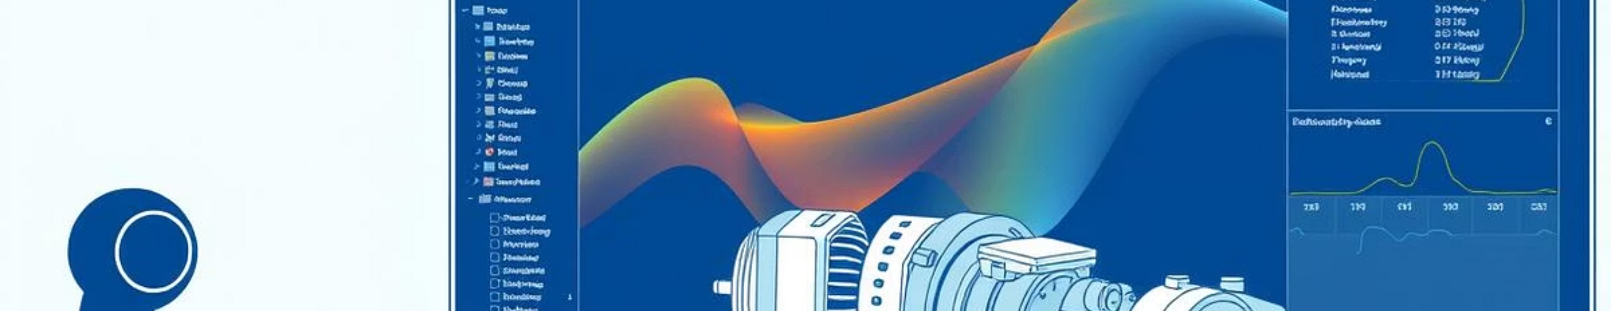
Project Overview
1
2
Static Analysis
Transient Analysis
Structural analysis of a pentagon model.
Time-dependent structural response.

Slide 3
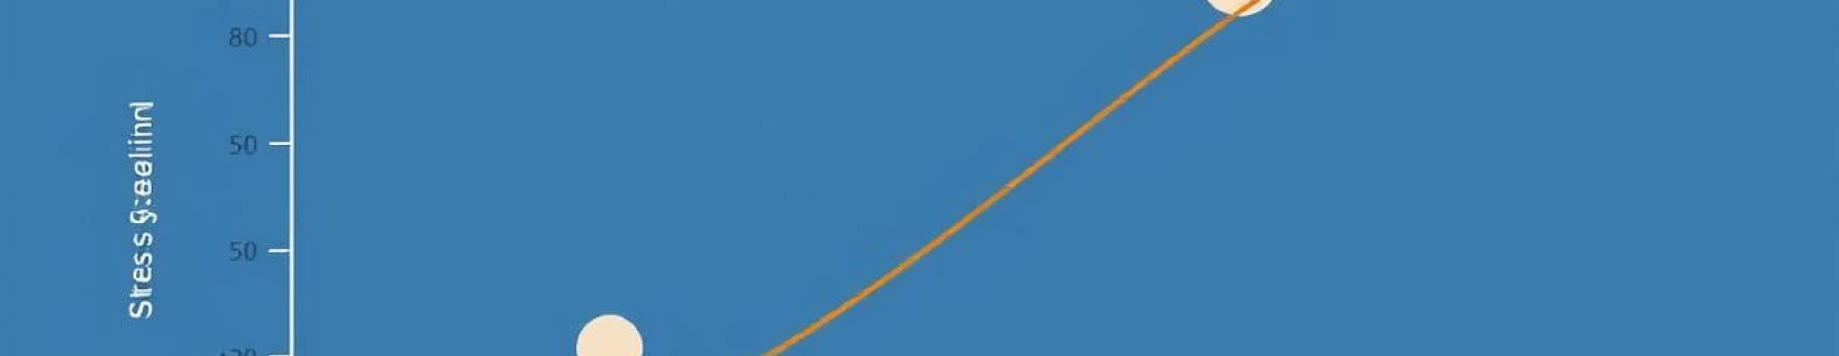
Key Parameters
Young’s Modulus
Poisson’s Ratio
96 × 10³ MPa
0.28
Static Load
Transient Load
2035 N (Remote Force)
281.72 N

Slide 4
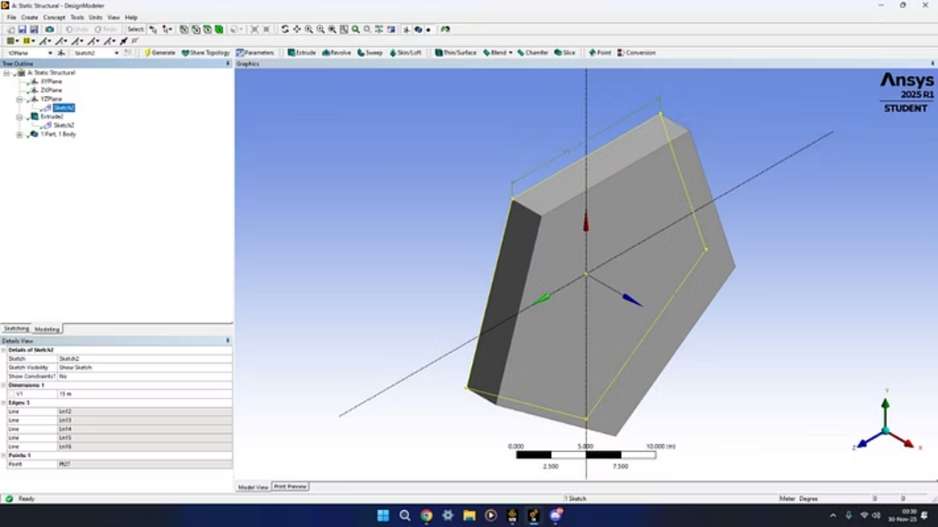
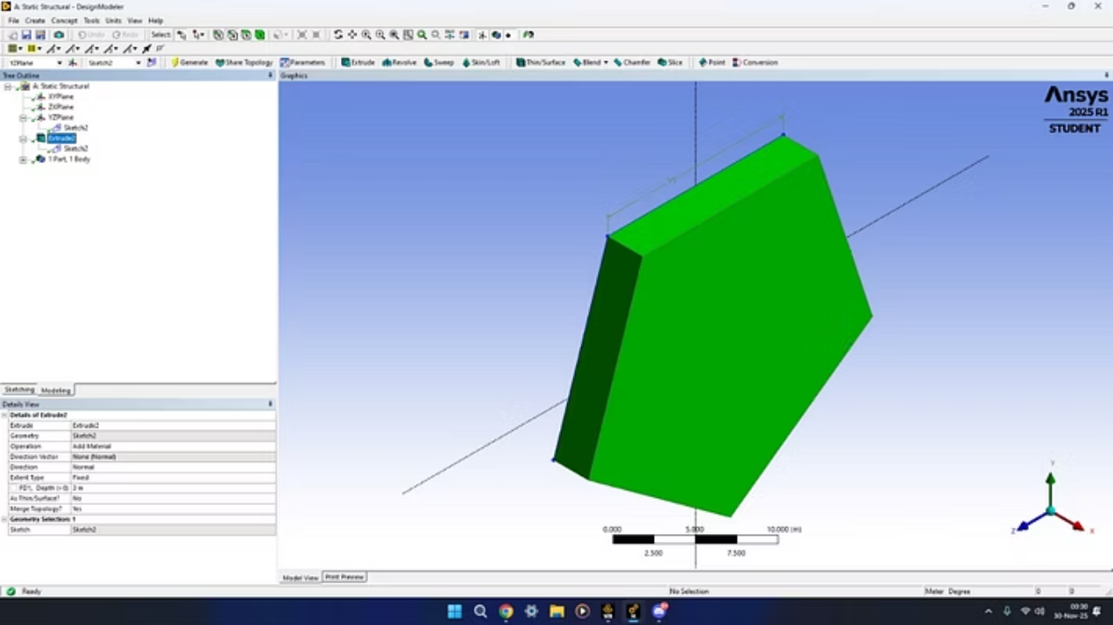
Static Simulation: Geometry
The pentagon model serves as the base for both static and transient analyses.

Slide 5
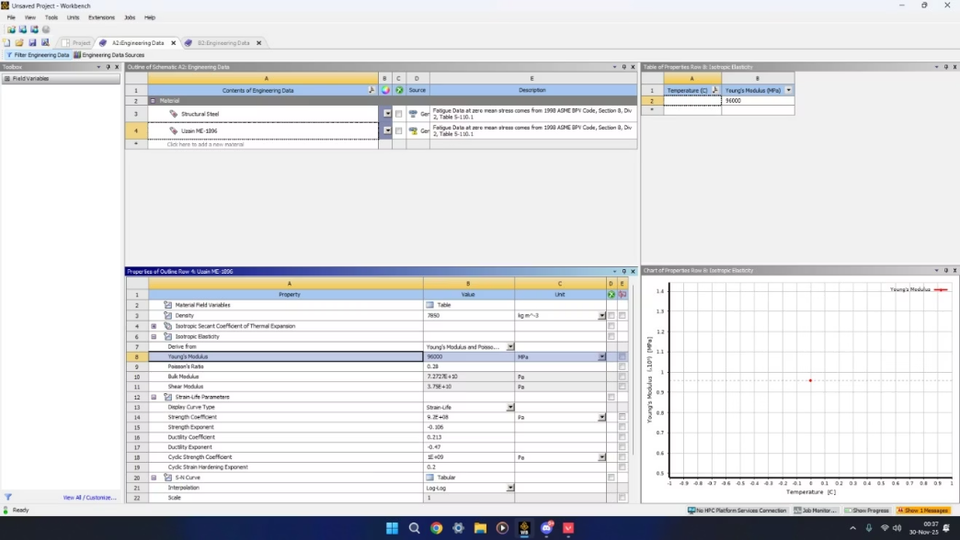
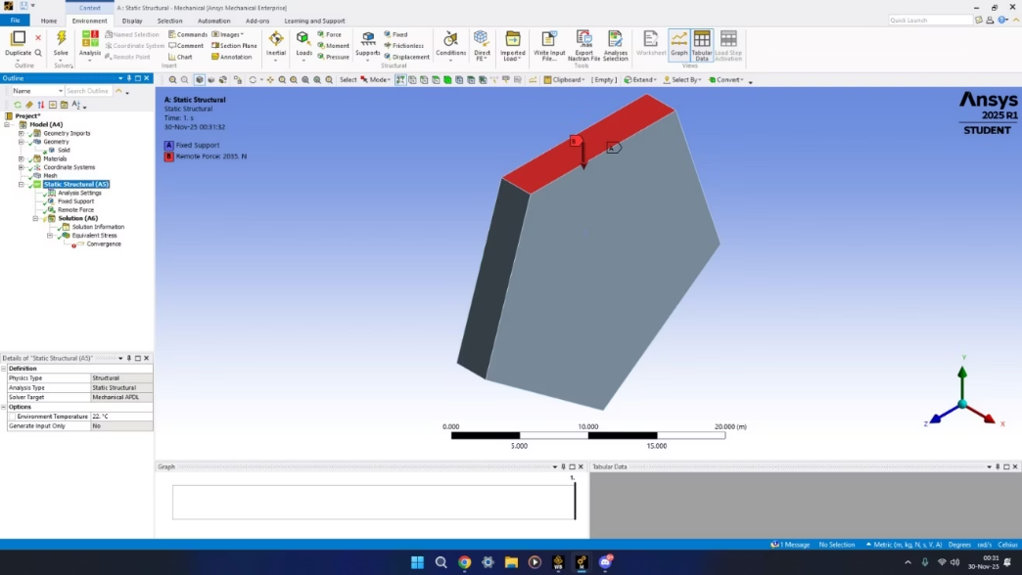
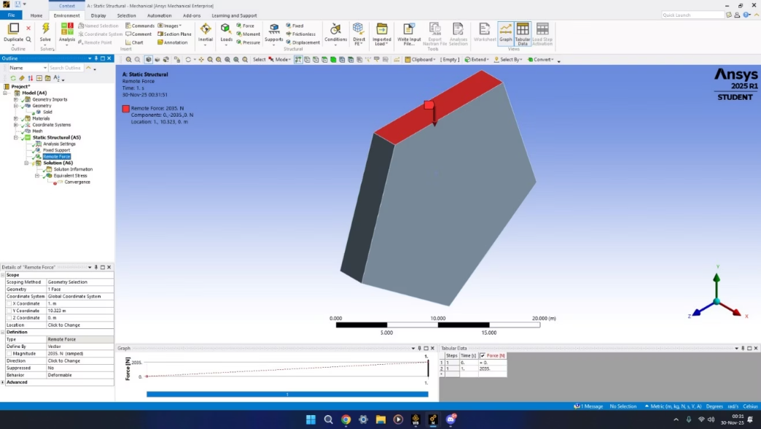
Static Simulation: Setup
Material Properties
Boundary Conditions
Young’s Modulus: 96 × 10³ MPa
One face fixed.
Poisson’s Ratio: 0.28
Remote force: 2035 N.

Slide 6
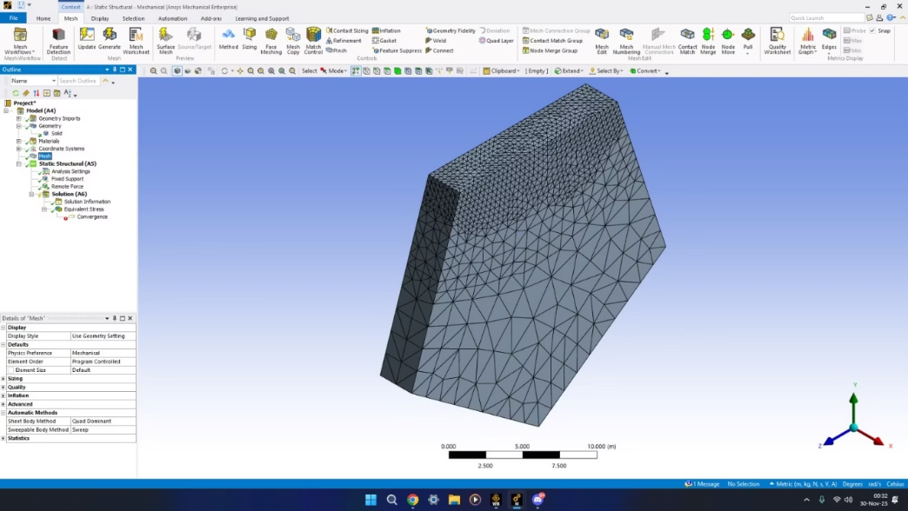
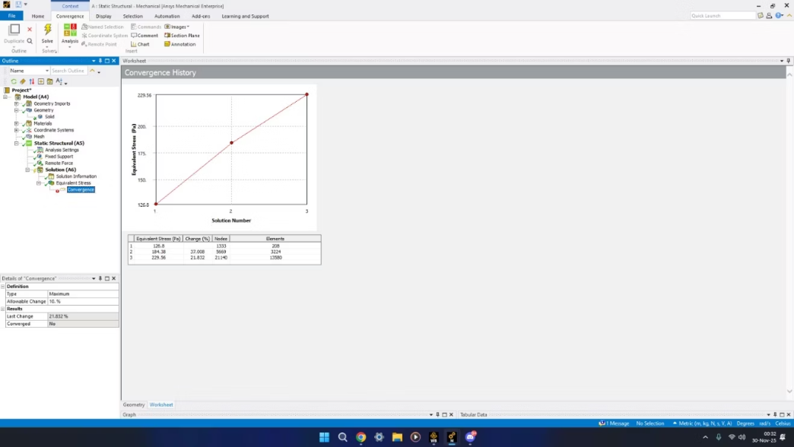
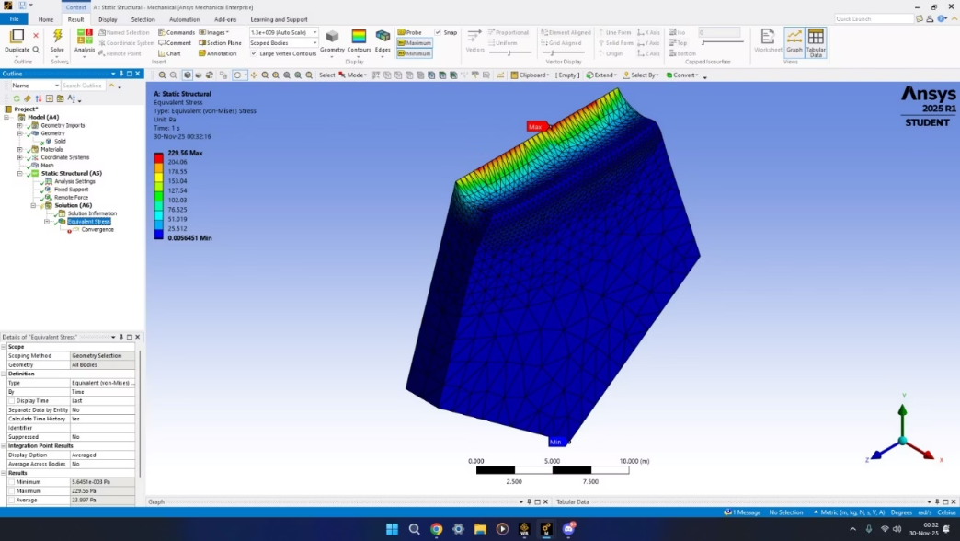
Static Simulation: Meshing & Results
Mesh Convergence
Von-Mises Stress
Refinement studies performed.
Equivalent stress distribution.

Slide 7

Transient Simulation: Overview
Same Geometry
1
Utilizes the identical pentagon model.
Same Materials
2
Young’s Modulus & Poisson’s Ratio.
Dynamic Loads
3
281.72 N on conic faces.
Time-Dependent
4
Analysis over 0.2s time step.

Slide 8
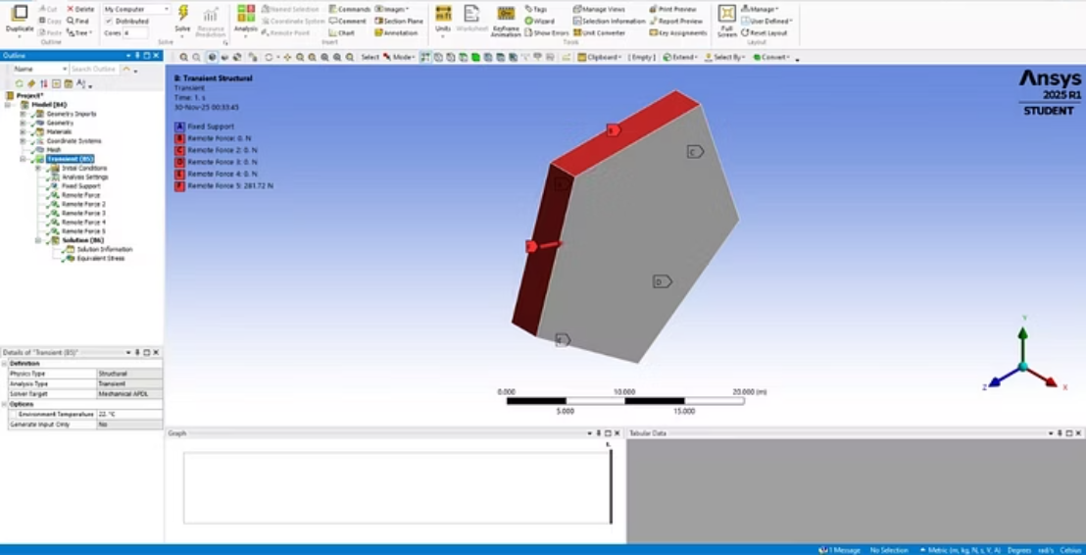
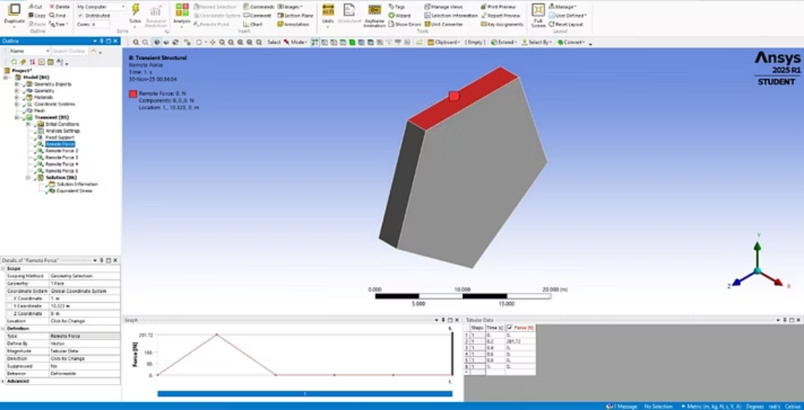
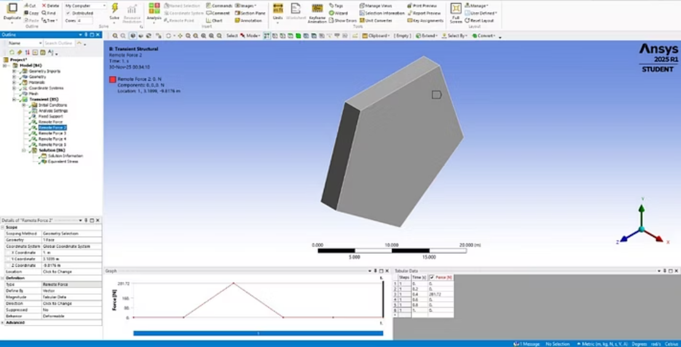



Transient Simulation: Boundary Conditions
Loads applied to selected conic faces without imprinting.

Slide 9
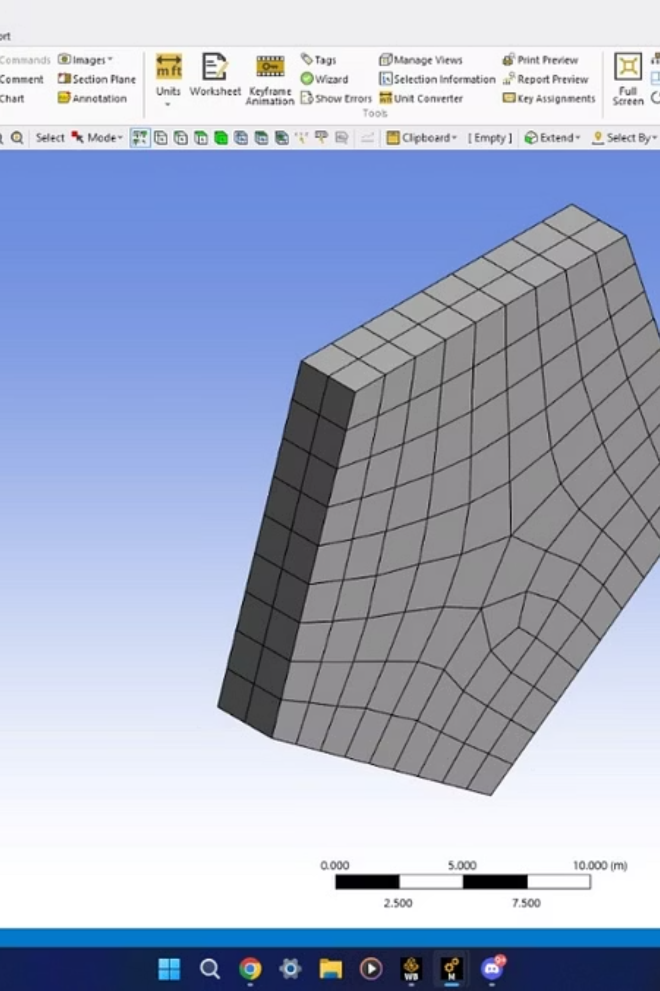

Transient Simulation: Meshing
Meshing for transient analysis.
Consistent meshing ensures accurate time-dependent results.

Slide 10
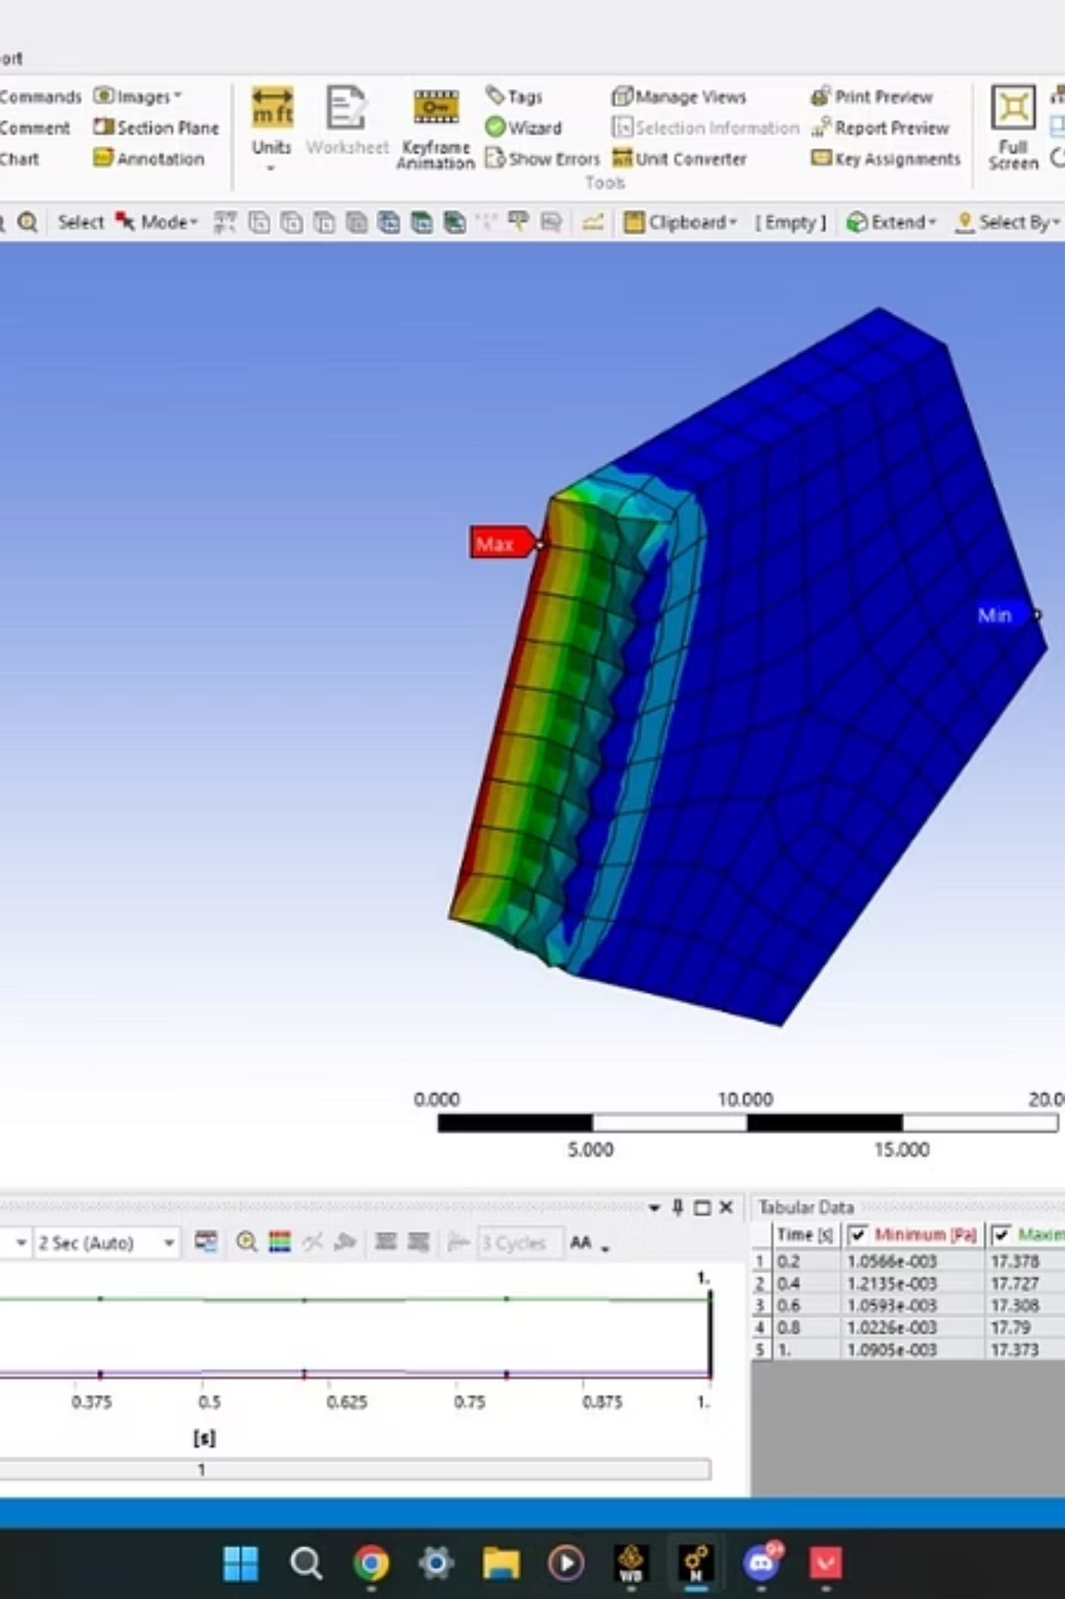

Transient Simulation: Results
Time-dependent deformation and stress variation.
Deformation
Visualizing structural changes over time.
Stress Variation
Analyzing dynamic stress responses.

